Slide 1
Big Data Processing
Jiaul Paik
IIT Kharagpur
Lecture 8

Slide 2
Graph (Network) Data Processing

Slide 3
Agenda
Basics of Graph Structure
Motivation
Algorithms
Graph Partitioning for community discovery
Counting Triangles in Graph
Graph Representation Learning

Slide 4
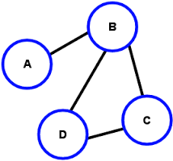
Graph Basics
A graph is composed of two things
Set of objects (called nodes of the graph)
Set of connections (called edges of the graph)
node
edge
Degree of a node = # adjacent nodes
Example: Degree(B) = 3

Slide 5
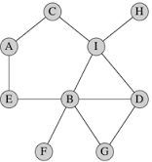
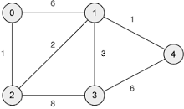
Types of Graph
Un-weighted
Edges do not have weight
Edges simply say whether two objects
are connected or not.
Weighted
Edges have weight
Examples:
Email communication network
How often two persons exchanging emails?
City and Road network
Edge weight: the distance between two cities

Slide 6
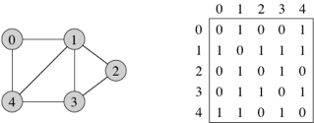
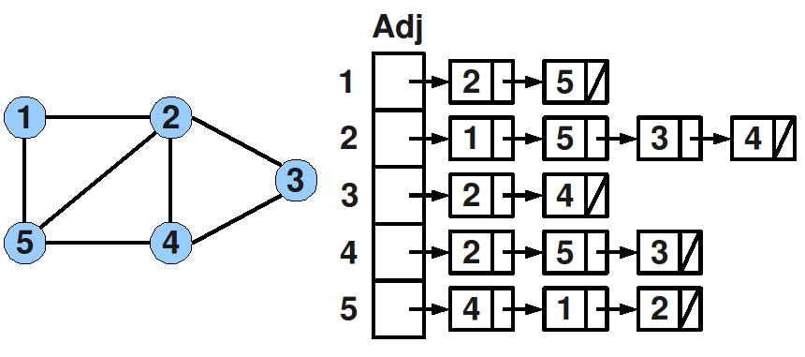
Representing Graph
Adjacency matrix:
Adjacency list:

Slide 7
Why Study Graphs?
Many real-life data and problems are modelled as graph structure
Facebook friendship network
Communities in question-answering website like Quora
And so on..

Slide 8
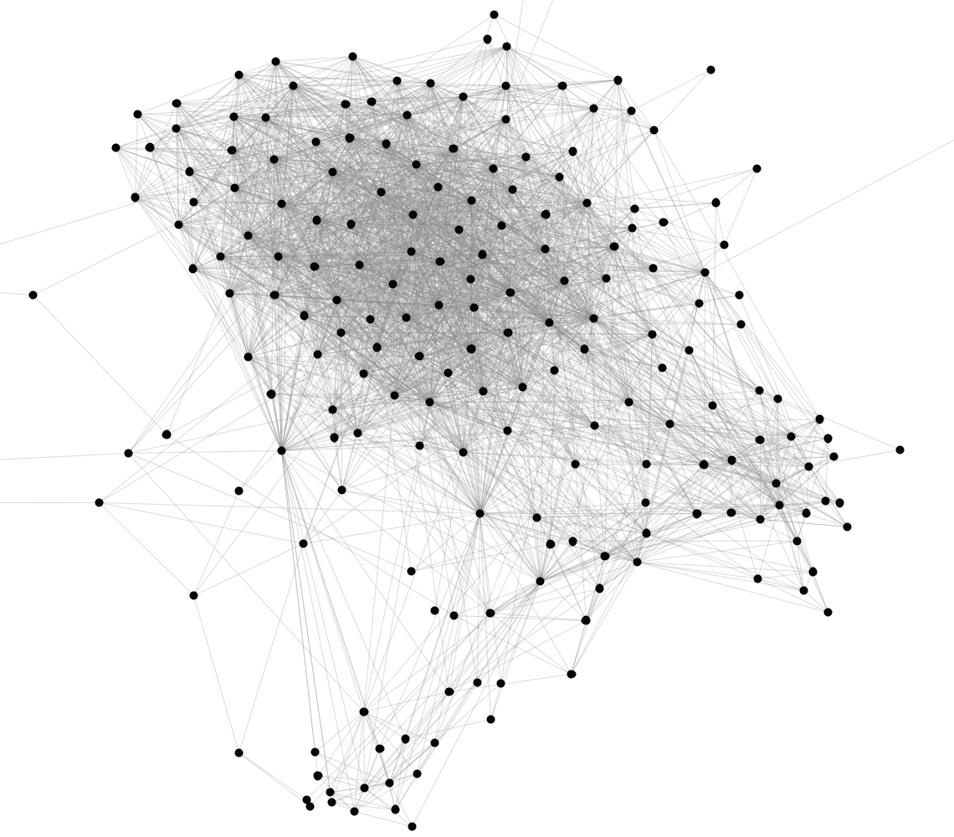
Stanford Facebook network
Nodes: Facebook Users
Edges: Friendships
Source: Jure Leskovec, Stanford

Slide 9
Graph Partitioning for Community Discovery

Slide 10
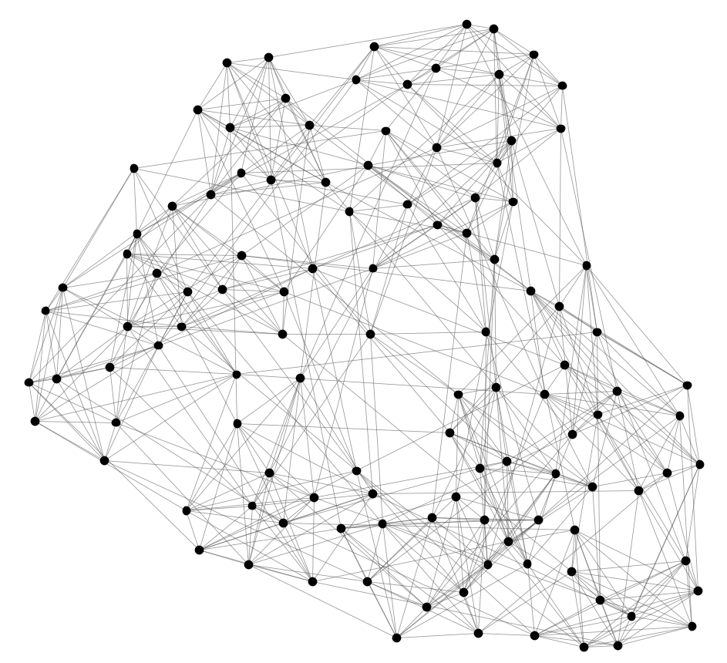
NCAA Football network
Can we identify node groups?
(communities, modules, clusters)
Nodes: Football Teams
Edges: Games played

Slide 11
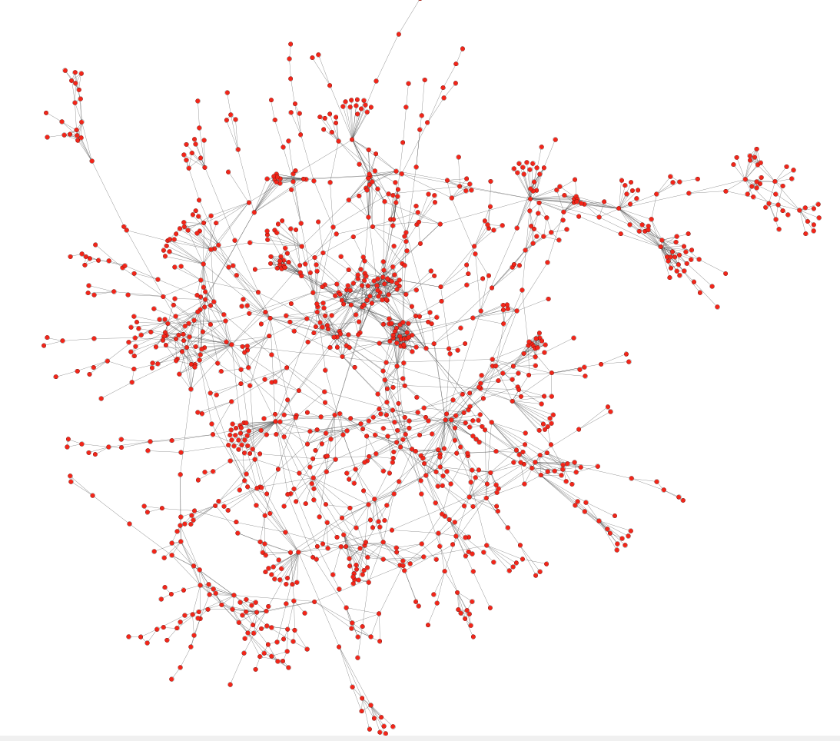
Protein-Protein interaction networks
Can we identify functional modules?
Nodes: Proteins
Edges: Physical interactions
Source: Jure Leskovec, Stanford

Slide 12
Stanford Facebook network
Can we identify social communities?
Nodes: Facebook Users
Edges: Friendships
Source: Jure Leskovec, Stanford

Slide 13
Communities
Real-life graphs are not random
In social network people pick their friends based on their common interests and activities
Nodes in a graph are typically organized in communities
Groups of nodes which probably share common properties

Slide 14
Community detection as clustering
Community detection is just clustering on graphs.
We can apply clustering algorithms on the adjacency matrix
(e.g., k-means)
We can define a distance or similarity measure between nodes in the graph and apply other algorithms (e.g., hierarchical clustering)
Graphs require specific algorithms

Slide 15
How do we find communities?
Main Characteristics of a community
Within-community nodes are densely connected
Between-community nodes are sparsely connected

Slide 16
The Girvan-Newman Algorithm
Reference: Networks, Crowds, and Markets: Reasoning about a Highly Connected World, Easley and Kleinberg

Slide 17
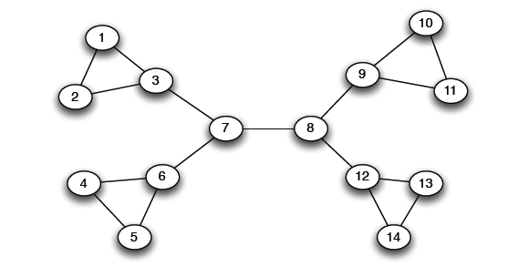
A Motivating Example
Which edge to remove?
“bridge”

Slide 18
The Girvan-Newman method
Hierarchical divisive method
Start with the whole graph
Find edges whose removal “partitions” the graph
Repeat with each subgraph until single vertices

Slide 19
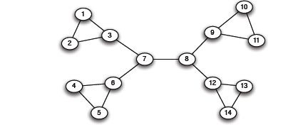
The Girvan-Newman method
Select bridge edges that when removed disconnect the graph
There may be many of those

Slide 20
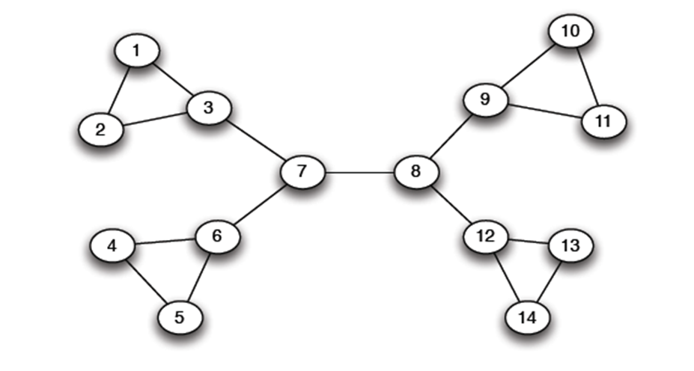
Edge importance
We need a measure of how important an edge is in keeping the graph connected
Edge betweenness: Number of shortest paths that pass through the edge

Slide 21
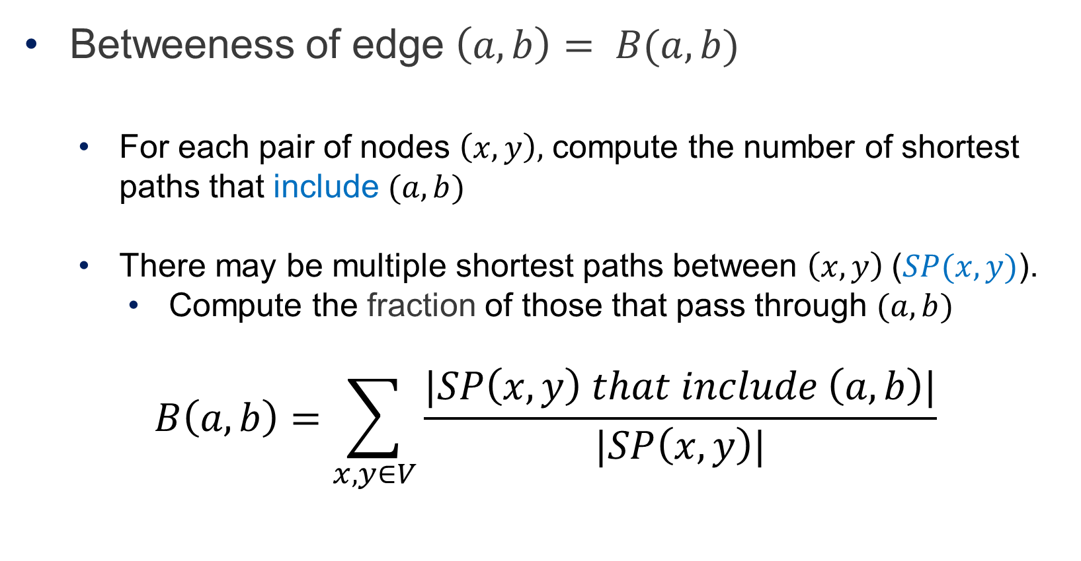
Edge Betweeness
Betweeness of edge $\left(a,b\right)= B(a,b)$
For each pair of nodes $\left(x,y\right),$ compute the number of shortest paths that include $(a,b)$
There may be multiple shortest paths between $\left(x,y\right) \text{(}SP(x,y)\text{)}$.
Compute the fraction of those that pass through $(a,b)$
$$B\left(a,b\right)=\sum_{x,y∈V}{\frac{|SP\left(x,y\right) that include \left(a,b\right)|}{|SP\left(x,y\right)|}}$$

Slide 22
Examples
3x11 = 33
1x12 = 12
7x7 = 49
1

Slide 23
The Girvan-Newman Algorithm
Given an undirected unweighted graph:
Repeat until no edges are left:
Compute the edge betweeness for all edges
Remove the edge with the highest betweeness
At each step of the algorithm, the connected components are the communities

Slide 24
Girvan Newman method: An example
Betweenness(7, 8) = 7x7 = 49
Betweenness(1, 3) = 1X12=12
Betweenness(3, 7) = Betweenness(6, 7) =
Betweenness(8, 9) = Betweenness(8, 12)= 3X11=33

Slide 25
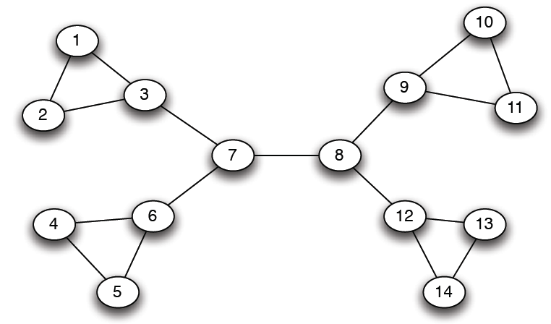
Girvan-Newman: Example
12
1
33
49
Need to re-compute betweenness at every step

Slide 26
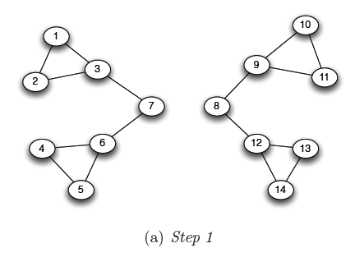
Girvan Newman method: An example
Betweenness(1, 3) = 1X5=5
Betweenness(3,7) = Betweenness(6,7) = Betweenness(8,9) = Betweenness(8,12) = 3X4=12

Slide 27
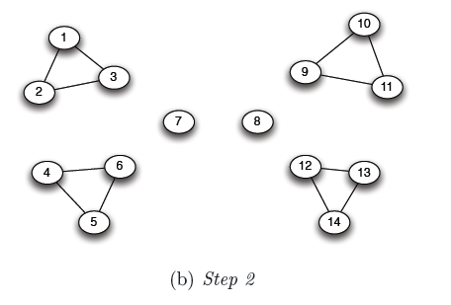
Girvan Newman method: An example
Betweenness of every edge = 1

Slide 28
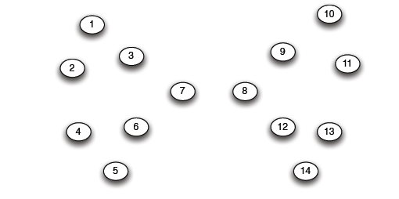
Girvan Newman method: An example

Slide 29
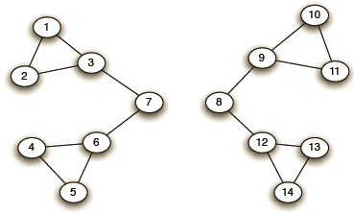
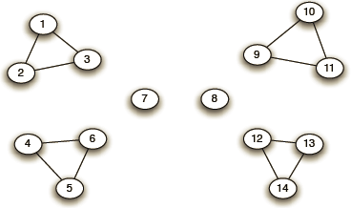
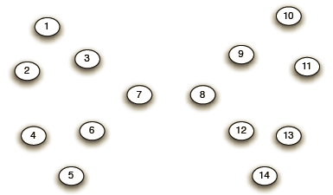
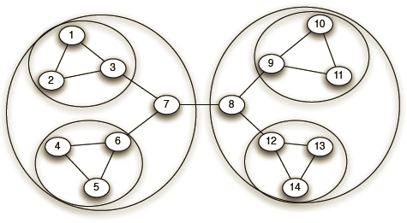
Girvan-Newman: Example
Step 1:
Step 2:
Step 3:
Hierarchical network decomposition:

Slide 30
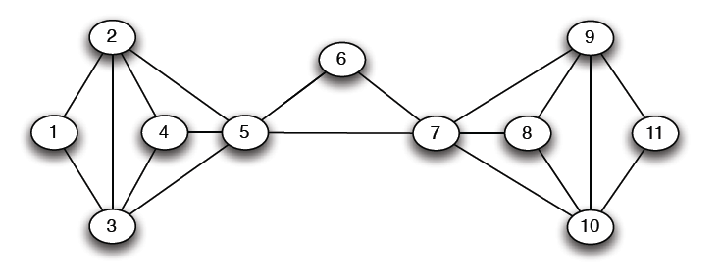
Another example
5X5=25

Slide 31
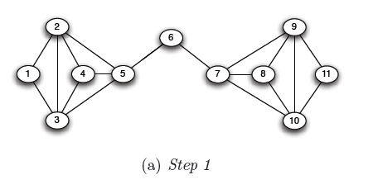
Another example
5X6=30
5X6=30

Slide 32
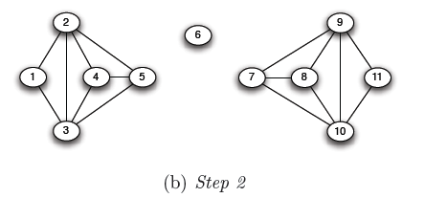
Another example

Slide 33
Computing Betweenness
Perform a Breadth-First-Search (BFS) starting from A
Determine the number of shortest path from A to each other node
Based on these numbers, determine the amount of flow from A to all other nodes that uses each edge

Slide 34
Counting Triangles

Slide 35
Problem Definition
Given an unweighted-undirected graph, find the number of three-node sets such that all three nodes are connected
Example:
2
1
3
4
Triangle: {2,3,4}

Slide 36
Why triangles are important?

Slide 37
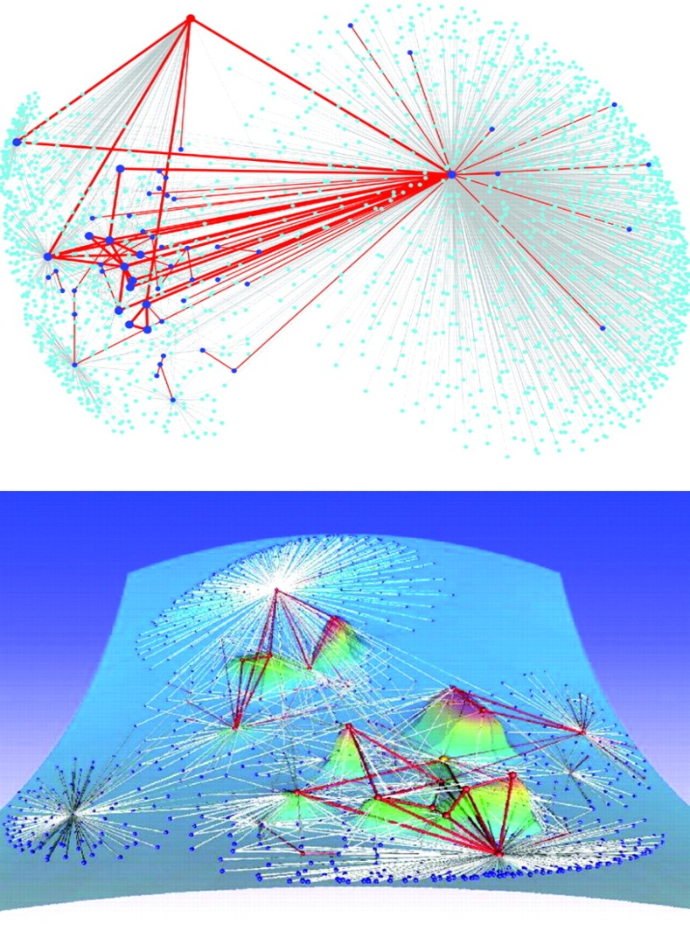
Example 1
Regions dense in triangles indicate a common topic!
Eckmann-Moses, Uncovering the Hidden Thematic Structure of the Web (PNAS, 2001)

Slide 38
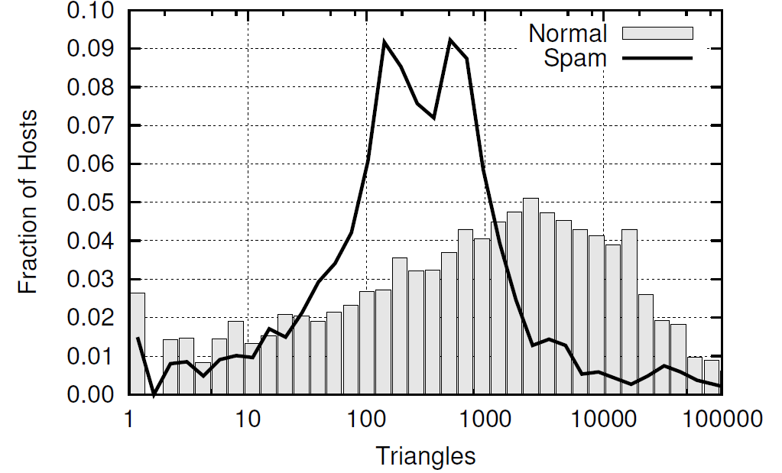
Example 2
Triangle Distribution among spam hosts is significantly different
from non-spam hosts!
Becchetti et al. KDD ‘08

Slide 39
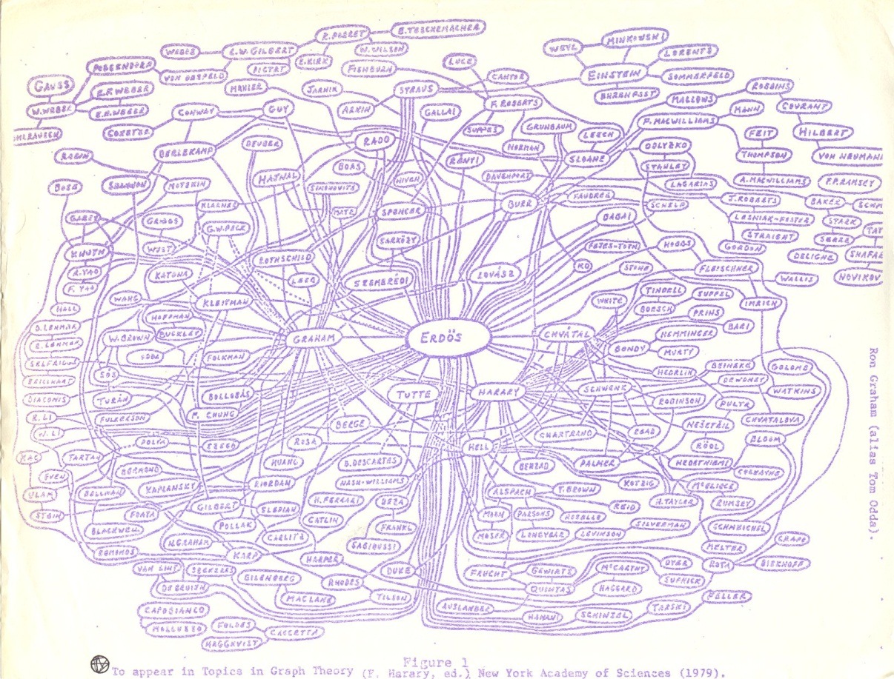
Example 3
Triangles used for assessing Content Quality in Social Networks
The amount of triangles in the self-centered social network of a user is a good indicator of the role of that user in the community!
Welser, Gleave, Fisher, Smith Journal of Social Structure 2007

Slide 40
Counting Exact Number of Triangles
Two simple approaches:
Node Iterator
count the edges among the neighbors of each vertex
Edge Iterator
count the common neighbors of the endpoints of each edge
Not practical for large graphs!!!

Slide 41
A Fast Triangle Counting Algorithm

Slide 42
Main Idea
Instead of treating all the nodes in similar fashion do:
Partition the vertices into “large” and “small” degree
Treat them appropriately

Slide 43
Graph Setup
We have an unweighted and undirected graph G with
n nodes
edges (m >=n)
The nodes are numbered: 1, 2, …. n (integers)

Slide 44
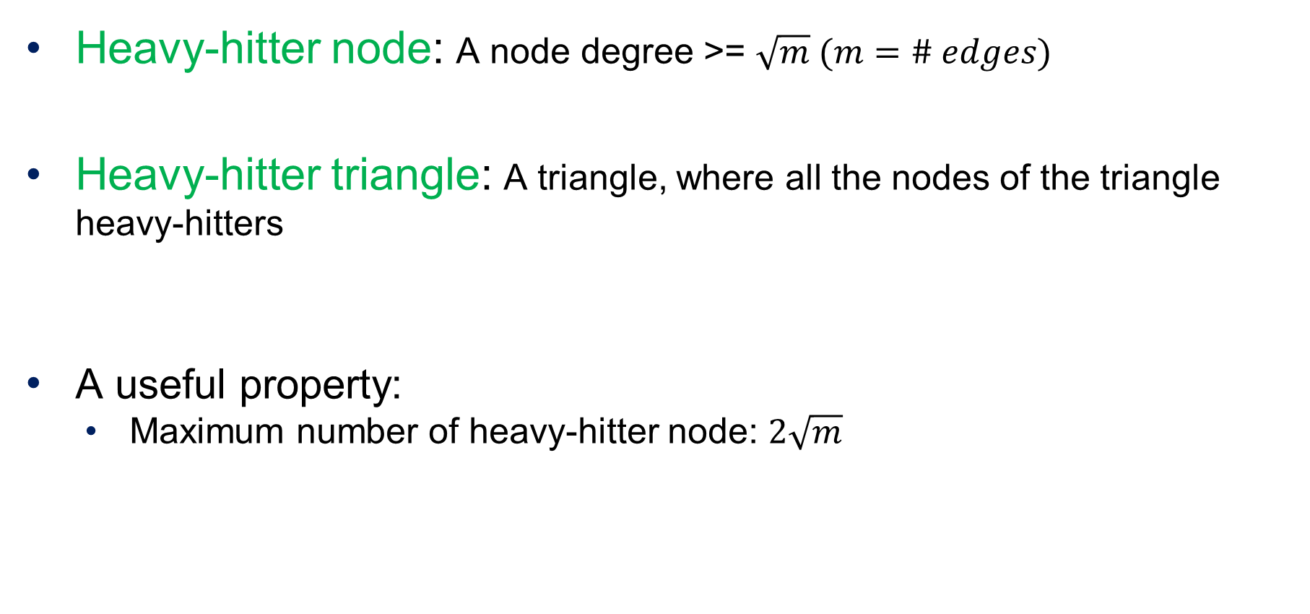
Key concepts based on node degrees
Heavy-hitter node: A node degree >= $\sqrt{m} (m=\# edges)$
Heavy-hitter triangle: A triangle, where all the nodes of the triangle heavy-hitters
A useful property:
Maximum number of heavy-hitter node: $2\sqrt{m}$

Slide 45
The Main Algorithm
Consists of two stages
Preprocessing stage
Goal is to quickly find out the following three things
Heavy-hitter nodes
Existence of an edge between two nodes
List of adjacent nodes
Triangle counting stage
Counting triangles based on heavy-hitter nodes
Counting other triangles

Slide 46
Preprocessing stage
Compute the degree of each node
Objective: To separate heavy-hitters from the non-heavy hitters
Time: O(m)
Create an index (hash table) on edges with pair of nodes of the edge as the key
Objective: To find if an edge between two nodes exists
Time: O(m)
Adjacency list for each node v
Objective: To find set of adjacent nodes of a given node
Time: O(degree(v))

Slide 47
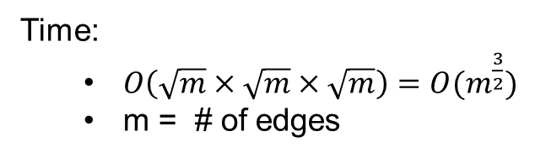
Triangle Counting Stage
Count heavy-hitter triangles:
Take the heavy hitter nodes, H (say)
Consider all sets of three nodes in H
Using the hash table, check if the edge between them exists
Time:
$O\left(\sqrt{m}×\sqrt{m}×\sqrt{m}\right)=O(m^{\frac{3}{2}})$
m = # of edges

Slide 48
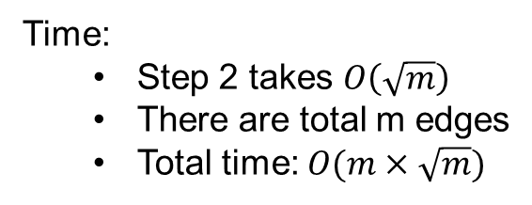
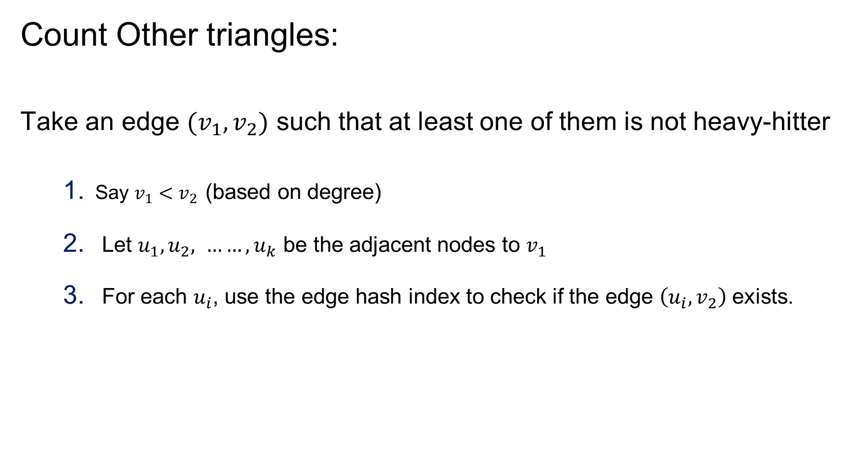
Triangle Counting Stage
Count Other triangles:
Take an edge $(v_{1},v_{2})$ such that at least one of them is not heavy-hitter
Say $v_{1}<v_{2}$ (based on degree)
Let $u_{1}, u_{2}, ……, u_{k}$ be the adjacent nodes to $v_{1}$
For each $u_{i}$, use the edge hash index to check if the edge $\left(u_{i}, v_{2}\right)$ exists.
Time:
Step 2 takes $O\left(\sqrt{m}\right)$
There are total m edges
Total time: $O(m×\sqrt{m})$

Slide 49
Fast Graph Partitioning for Community Discovery

Slide 50
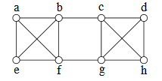
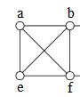
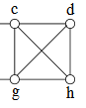
Graph Partitioning: Minimum Cut
Minimum cut of a graph
Partition on nodes in two groups $S_{1} and S_{2}$ so that the # edges between $S_{1} and S_{2}$ are minimized
Example
For the above graph, the min cut partition is {a,b,e,f} and {c,d,g,h}

Slide 51
Graph Partitioning using Min Cut
Use a min cut algorithm to break a graph into two sets
Use the min cut algorithm to further break the smaller graphs

Slide 52
Karger’s Min Cut Algorithm
The algorithm is based on edge contraction
Repeat until just two nodes remain
Pick an edge at random
Collapse its two endpoints into a single node

Slide 53

Karger’s Min Cut Algorithm
It stands on two keys things
Randomized decision (which edge to choose next)
Edge contraction: Collapse its two endpoints into a single node
1
2
1
2,3
3

Slide 54
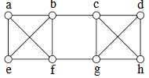
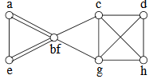
Karger’s Min Cut Algorithm: Example
14 edges to choose from (Pick b –f with prob 1/14)
Source: Sanjeev Arora, Princeton University

Slide 55
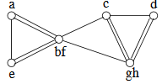
Karger’s Min Cut Algorithm: Example
13 edges to choose from Pick g - h with prob 1/13

Slide 56
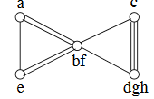
Karger’s Min Cut Algorithm: Example
12 edges to choose from Pick d - gh with prob 2/12

Slide 57
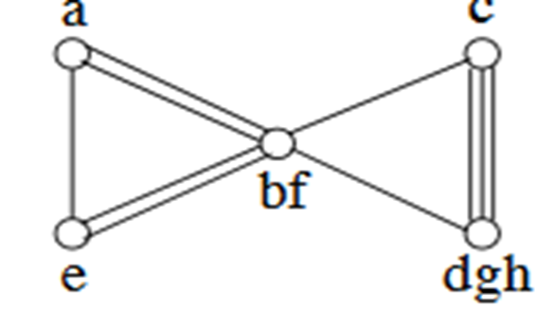
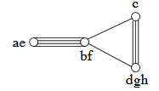
Karger’s Min Cut Algorithm: Example
10 edges to choose from Pick a - e with prob 1/10

Slide 58
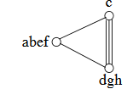
Karger’s Min Cut Algorithm: Example
9 edges to choose from Pick ae – bf with prob 4/9

Slide 59
Karger’s Min Cut Algorithm: Example
5 edges to choose from Pick c - dgh with prob 3/5
Cut value: 2
# of parallel edges in the final two-node graph
DONE: just two nodes

Slide 60
Karger’s Min Cut Algorithm
An Important Note
It is a randomized algorithm
Therefore, for good result do the following
Run Karger’s algorithm multiple times
(it will produce multiple cuts)
Take the cut with the minimum value

Slide 61
Representation Learning on Graph

Slide 62
Embedding Nodes
Input
Output
Represent each node as d-dimensional vector so that “similar” nodes in the graph have similar vectors
Mining Massive Datasets, Jure Leskovec

Slide 63
Setup
Assume we have a graph G:
V is the vertex set.
A is the adjacency matrix

Slide 64
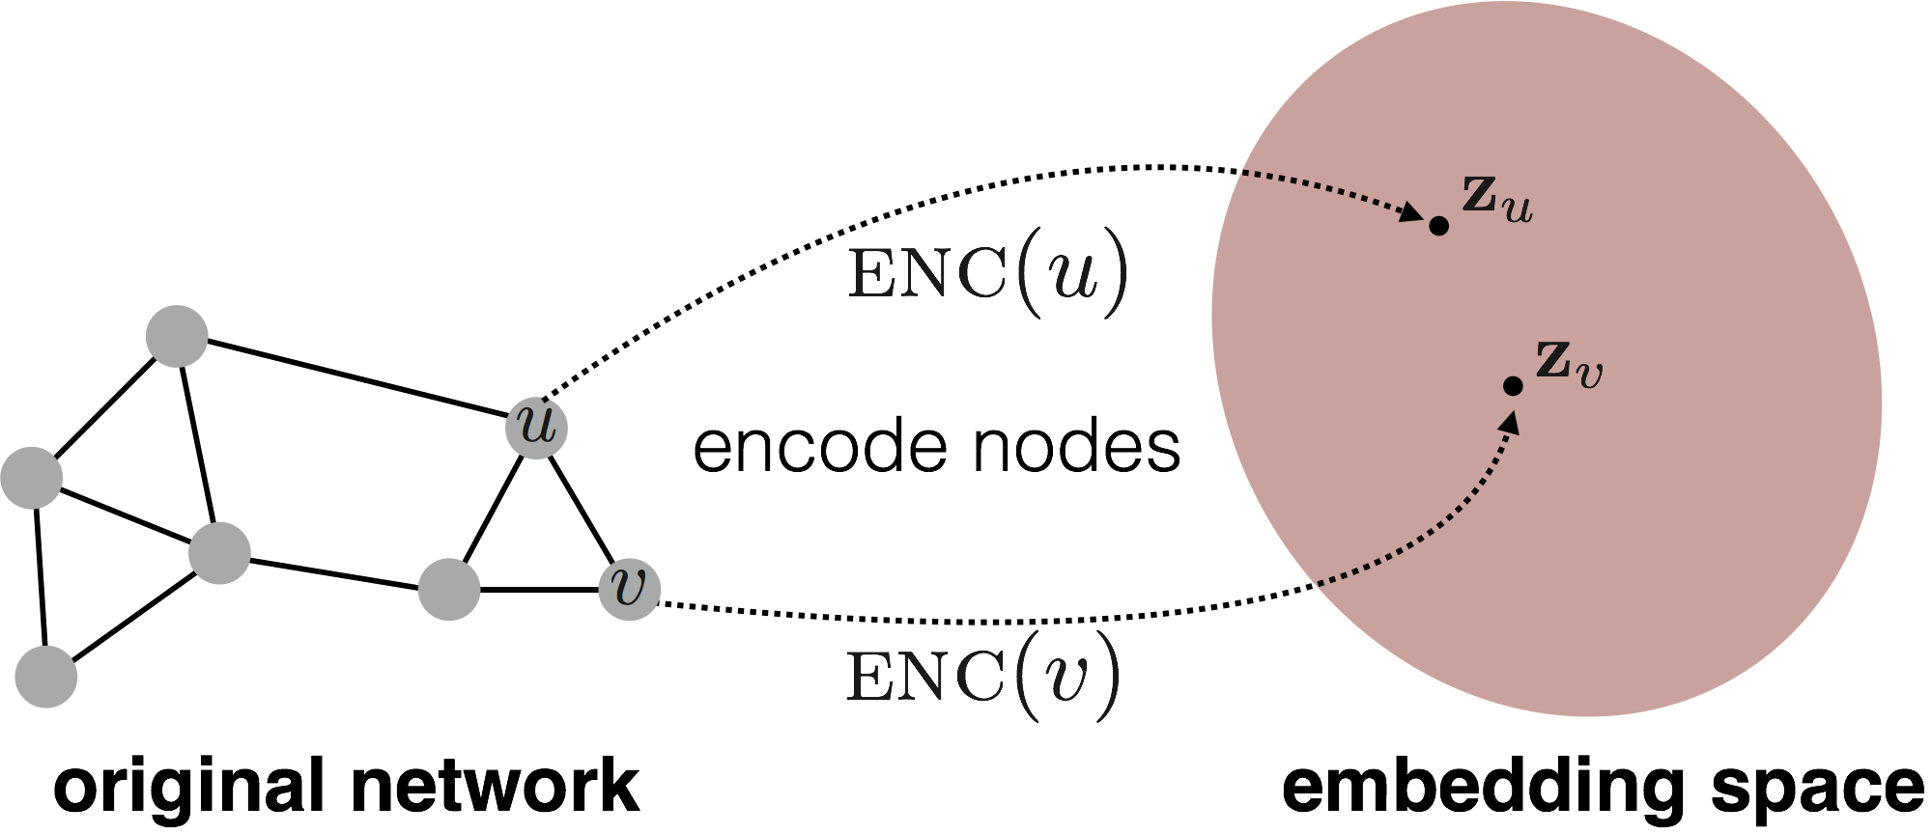
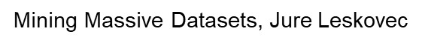
Embedding Nodes
Goal is to encode nodes so that similarity in the embedding space approximates similarity in the original network.

Slide 65
Node Embedding
Goal:
Mining Massive Datasets, Jure Leskovec

Slide 66
Learning Node Embeddings
Define an encoder (i.e., a mapping from nodes to embeddings)
Define a node similarity function (i.e., a measure of similarity in the original network).
Optimize the parameters of the encoder so that:

Slide 67
Two Key Components
Encoder maps each node to a low-dimensional vector.
Similarity function specifies how relationships in vector space map to relationships in the original network.

Slide 68
Outline: Approaches to Similarity
Adjacent Neighbor based similarity
Multi-hop based similarity
Random walk based similarity

Slide 69
Adjacent neighbor based similarity

Slide 70
Similarity = the edge weight between u and v in the original network.
Intuition = Dot products between node embeddings approximate edge existence.
Loss function
embedding similarity
(weighted) adjacency matrix for the graph
sum over all node pairs

Slide 71
How to Find the Embedding vectors?
Objective: Find all $Z∈ℝ^{d x |V|}$ such that loss $ℒ$ is minimum
Method: Use stochastic gradient descent (SGD) as a general optimization method.
Highly scalable approach

Slide 72
Drawbacks
O(|V|²) runtime. (Must consider all node pairs.)
Only considers direct, local connections.

Slide 73
Multi-hop Similarity Based Approach

Slide 74
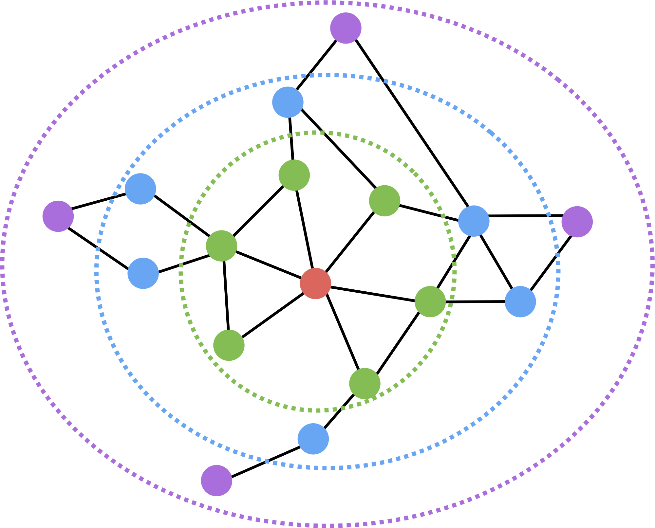
Multi-hop Similarity
Consider k-hop neighbors for each node.
Red: Target node
Green: 1-hop neighbors
Blue: 2-hop neighbors
Purple: 3-hop neighbors

